Slide 1


Why Normalization?

Slide 2


Lecture Checklist
Why Normalization?
Types of Normalization.

Slide 3
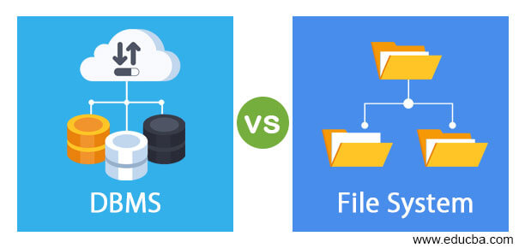

Why Normalization?
VS

Slide 4
Types of Normalization.
First Normal Form (1NF)
Second Normal Form (2NF)
Normal Forms
In DBMS
Third Normal Form (2NF)
Boyce- codd Normal Form (BCNF)

Slide 5
THANK YOU

